Slide 1
Content analysis of articles on viral epidemics
Ayush Garg
ayush@science.org.in
(OpenVirus)

Slide 2
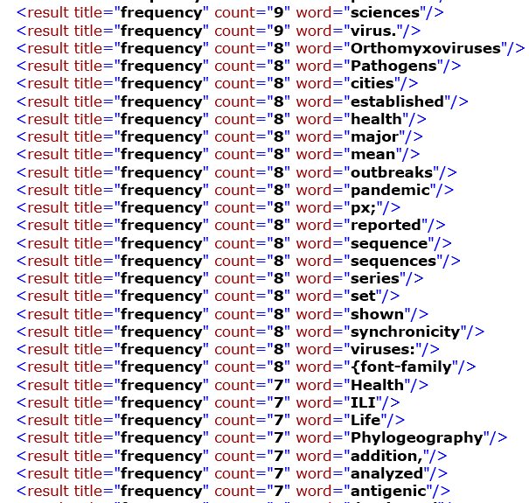
Prepare graph for occurrences of words
Occurrences of words in Papers
Visualising of data

Slide 3
We take this kind data from every paper and annotate it with our dictionaries to extract meaningful results

Slide 4
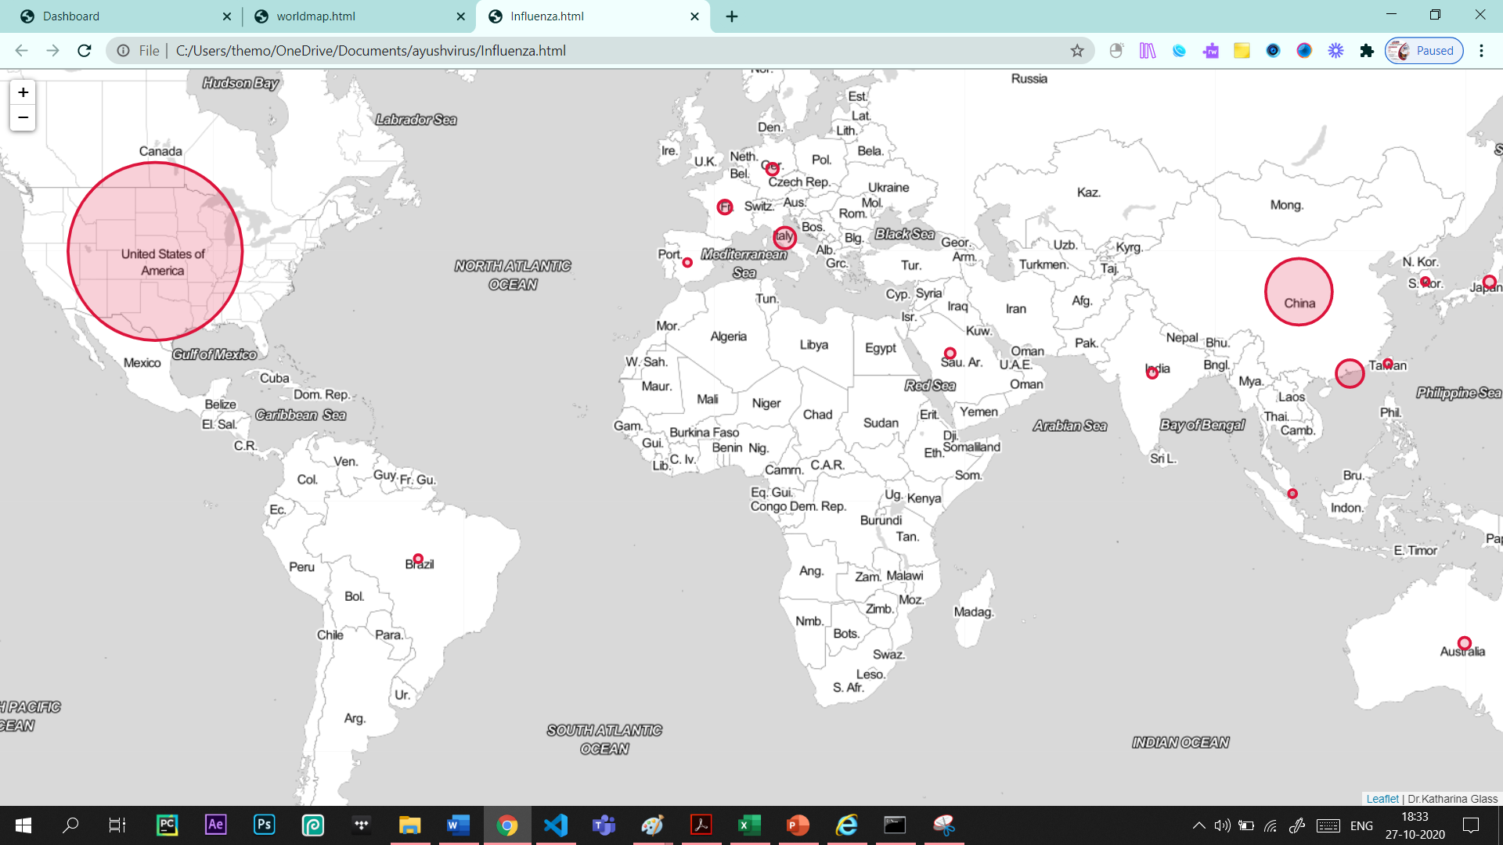
This graph shows mentions of countries in articles about influenza

Slide 5
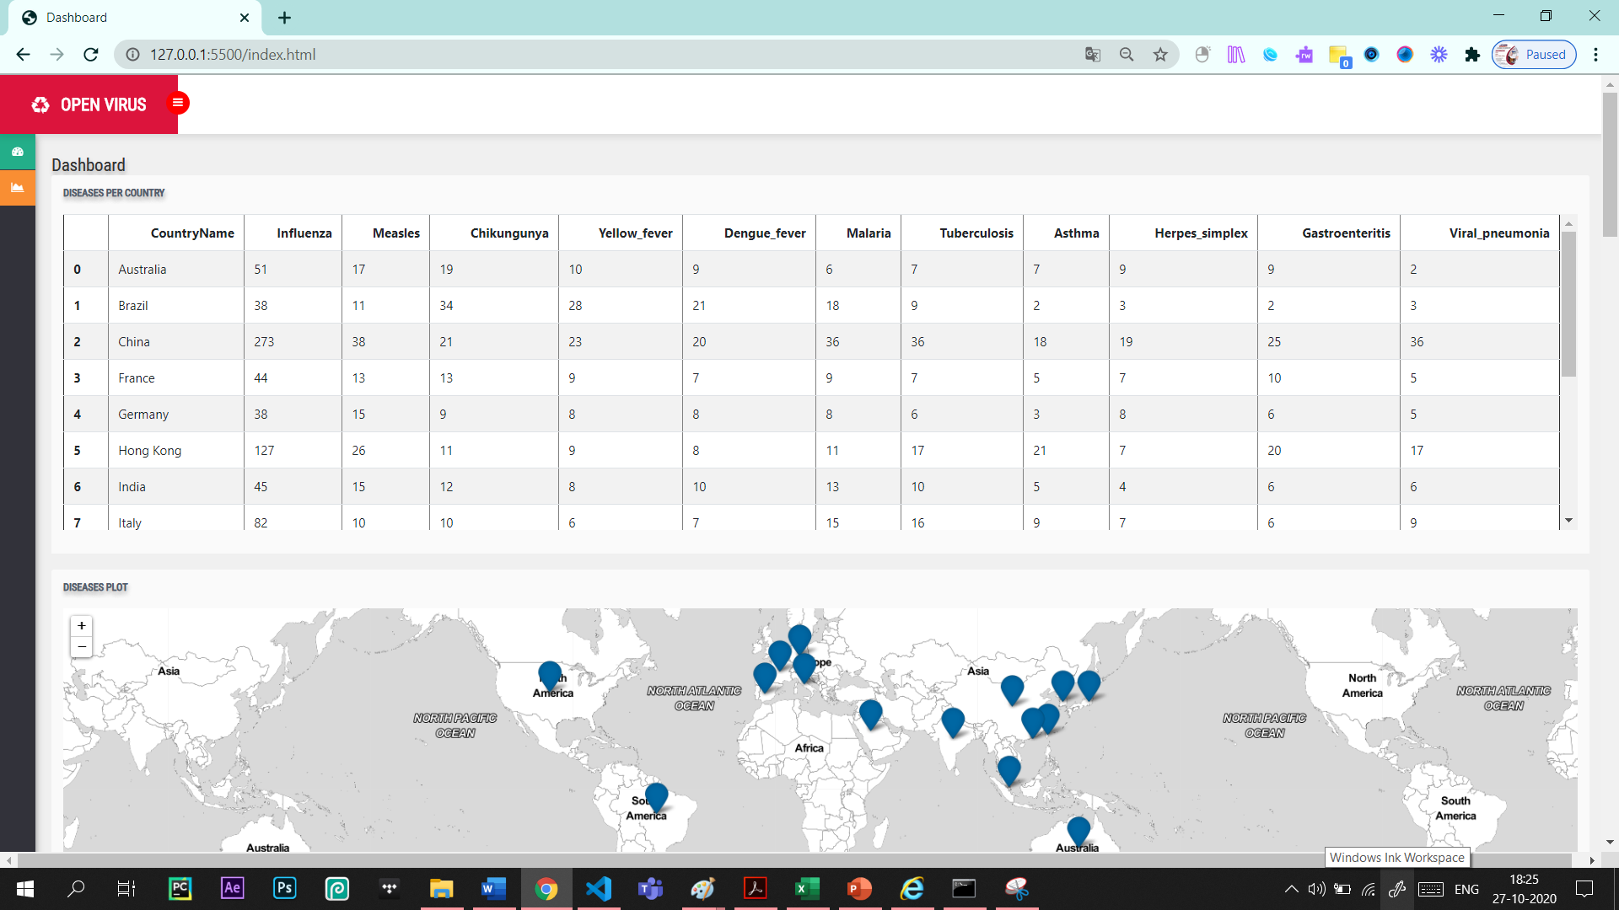
Stitching all the graphs
We make a beautiful dashboard out of all this

Slide 6
This Jupyter notebook analyzes search results for articles on virus and epidemic and is self sufficent so we don’t need to install any dependencies. It makes all the files itself. You will also find all the graphs separately in your working directory. Location: https://github.com/petermr/openVirus/tree/master/jupyter/AGData Installation: 1) Clone the folder onto your local machine 2) To make the dashboard, just run the main.ipynb file and all the graphs along with the index.html file which Is the dashboard will be created. 3) To make plots out of occurrences of words in research papers, open frequency-display.ipynb. Add a folder with all the search results and change the value of the variable to the path to the folder. The code will the make the graphs for the papers and save them.

Slide 7
100,000,000
More than
Research papers are there in the world.
Imagine the knowledge we can extract if all of them are open access.

Slide 8

We welcome every question.
Special thanks to all my team members
See the following links:
https://github.com/petermr/openVirus --OpenVirus Repo

